Slide 1
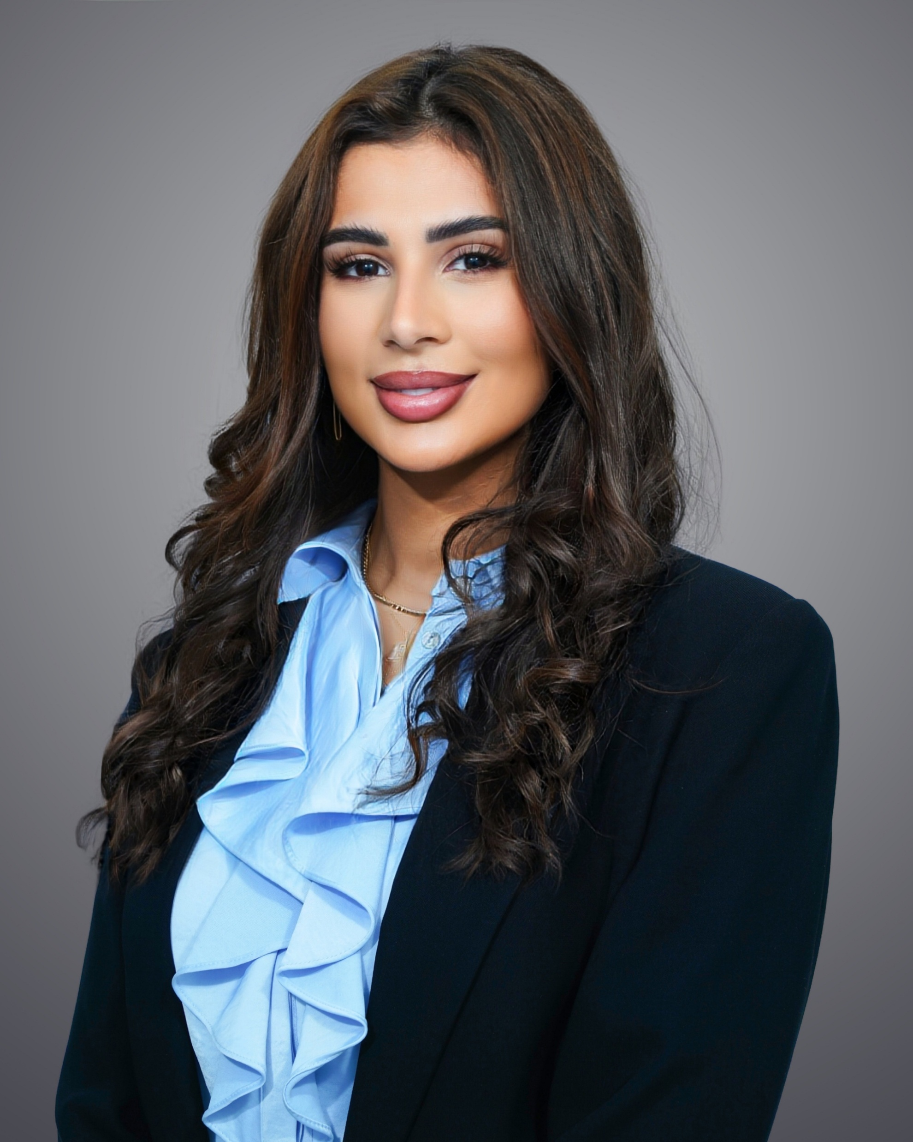
AREAS OF EXPERTISE
PROFESSIONAL EXPERIENCE
Internal Audit
Quality Assurance
Quality Management Systems
Compliance & Risk Assessment
Travel and Tourism consultancy
Stakeholder Engagement
Research & Analysis
Business Continuity Management
Farah is a Certified Quality Management and GRC professional with over 10 years of experience supporting organizations in strengthening governance frameworks, financial controls, and risk management practices across both public and private sectors. She has a strong track record in leading ISO 9001:2015 implementations, internal audit engagements, and risk advisory projects, helping organizations enhance transparency, accountability, and operational efficiency. Her work focuses on designing and improving control environments, policy frameworks, and process governance structures that support effective financial oversight, fraud risk mitigation, and compliance with international standards. Prior to transitioning into consulting, she developed strong operational and commercial experience in the travel industry, managing corporate accounts and optimizing service delivery for global networks. Farah combines risk-based thinking, structured process design, and governance expertise to help organizations strengthen internal controls, support sound decision-making, and drive continuous improvement.
INDUSTRY EXPERTISE
Public Health Regulatory
Travel and Tourism Management
Hospitality Management
Stock Market
Communications and Information Technology
RELEVANT EXPERIENCE
Farah Srour
(1/3)
Key Responsibilities and Achievements:
ISO 22301:2019 Business Continuity Management System (BCMS) Implementation – Ministry of Public Health – Doha, Qatar (ongoing)
Support in the BCMS implementation initiative, conducting a comprehensive gap assessment to evaluate current continuity maturity and identify key improvement areas, followed by delivery of targeted awareness workshops to strengthen organizational resilience.
Support in developing the BCMS framework policy and executed Business Impact Analysis (BIA) across 25 departments, identifying critical functions, dependencies, and recovery priorities.
Conducting risk assessments for critical processes to identify potential threats and enhance continuity readiness across departments.
Developing Business Continuity Plans (BCPs) aligned with BIA and risk assessment outputs and delivering training and awareness sessions to support effective BCMS implementation across the Ministry.
ISO 9001:2015 QMS implementation at the Ministry of Communications and Information Technology, Doha.
Led the end-to-end implementation of the ISO 9001:2015 Quality Management System, conducting a comprehensive governance, risk, and internal controls gap assessment that identified more than 30 non-conformities, control deficiencies, and potential fraud risk exposures.
Senior Consultant
PROFESSIONAL MEMBERSHIPS, CERTIFICATIONS
ISO 9001:2015 Lead Auditor
ISO 23592:2021 Lead Implementer
Certified GRC Auditor (GRCA) - OCEG
Certified GRC Professional (GRCP) – OCEG
YEAR OF EXPERIENCE
10
EDUCATION
Bachelor in Travel and Tourism Management – Lebanese University
Research Master’s in Tourism Sciences – Lebanese University
IATA Diploma with Distinction

Slide 2

AREAS OF EXPERTISE
RELEVANT EXPERIENCE (Cont’d)
Internal Audit
Quality Assurance
Quality Management Systems
Compliance & Risk Assessment
Travel and Tourism consultancy
Stakeholder Engagement
Research & Analysis
Business Continuity Management
Standardized and formalized over 400 governance documents—including policies, procedures, and internal control processes—to strengthen organizational accountability and support consistent operational and financial oversight.
Enhanced control effectiveness over documented processes by 40%, improving monitoring mechanisms and strengthening compliance with established governance frameworks.
Delivered QMS and internal audit awareness training, ensuring departments clearly understood compliance requirements, control responsibilities, and their roles in maintaining effective governance.
Supported departments in executing internal audits by preparing the audit plan, developing the audit program, and creating risk-based audit checklists aligned with ISO 9001 standards.
Supported the organization in the management review process, enabling leadership to evaluate performance metrics, governance effectiveness, and improvement opportunities.
Contributed to certification-readiness activities, ensuring the organization meets all ISO requirements ahead of the external audit.
ERM internal audit for Qatar Stock Exchange, benchmarking against COSO and ISO 31000 standards, Doha.
Assessed enterprise governance, risk management, and internal control practices, validating the completeness and reliability of enterprise-wide risk registers and confirming accountability for the top 15 strategic risks.
Evaluated the effectiveness of risk governance structures, oversight mechanisms, and internal control processes impacting financial, operational, and fraud risk exposure.
Designed a risk-based internal audit methodology aligned with QSE’s ERM framework to support improved risk monitoring and reporting.
Conducted stakeholder interviews and risk workshops to assess process maturity, control effectiveness, and risk management integration across business functions.
Quality Operations and Business Excellence Officer (ISO 9001:2015).
      Played a key role in developing and executing the firm’s strategy, ensuring cross-functional alignment and overseeing strategic initiatives across departments such as Events, PR, and Social Media, while managing teams and coordinating with business units.
      Led end-to-end ISO 9001:2015 implementation—from gap analysis and project planning to developing the Quality Manual and standardized procedures—resulting in successful external certification with no major non-conformities and establishing a framework for sustained compliance and continuous improvement.
      Conducted risk assessments, mapped and improved core/support processes, and implemented KPIs and KRIs to enhance process performance and resilience.
      Designed and executed internal audits, identifying control weaknesses and potential risk areas, ensuring over 95% closure of findings within 30 days, and consolidating audit insights to drive improvements.
INDUSTRY EXPERTISE
Public Health Regulatory
Travel and Tourism Management
Hospitality Management
Stock Market
Communications and Information Technology
Farah Srour
(2/3)
Senior Consultant
PROFESSIONAL MEMBERSHIPS, CERTIFICATIONS
ISO 9001:2015 Lead Auditor
ISO 23592:2021 Lead Implementer
Certified GRC Auditor (GRCA) - OCEG
Certified GRC Professional (GRCP) – OCEG
YEAR OF EXPERIENCE
10
EDUCATION
Bachelor in Travel and Tourism Management – Lebanese University
Research Master’s in Tourism Sciences – Lebanese University
IATA Diploma with Distinction

Slide 3
AREAS OF EXPERTISE
RELEVANT EXPERIENCE (Cont’d)
Internal Audit
Quality Assurance
Quality Management Systems
Compliance & Risk Assessment
Travel and Tourism consultancy
Stakeholder Engagement
Research & Analysis
Business Continuity Management
  Business Travel and Process Improvement specialist
  Led the implementation of Amex GBT corporate travel accounts, developed SOPs, achieved full onboarding compliance within 3 months, and standardized service processes, reducing errors by 25%.
  Ensured regulatory, partner, and ISO 9001:2015 compliance , supporting 100% audit success, maintaining quality records, improving internal documentation, and achieving over 90% customer satisfaction in post-travel surveys.
  Managed key operational activities, including T&E reporting with under 2% error rate and financial transactions with over 99% accuracy, strengthening controls and reducing risk of errors or misuse.
  Built strong partnerships with BSP, Amex, and airlines , managed VIP travel services with a complaint rate below 1% and maintained zero SLA breaches over 18 months.
INDUSTRY EXPERTISE
Public Health Regulatory
Travel and Tourism Management
Hospitality Management
Stock Market
Communications and Information Technology
Farah Srour
(3/3)
Senior Consultant
PROFESSIONAL MEMBERSHIPS, CERTIFICATIONS
ISO 9001:2015 Lead Auditor
ISO 23592:2021 Lead Implementer
Certified GRC Auditor (GRCA) - OCEG
Certified GRC Professional (GRCP) – OCEG
YEAR OF EXPERIENCE
10
EDUCATION
Bachelor in Travel and Tourism Management – Lebanese University
Research Master’s in Tourism Sciences – Lebanese University
IATA Diploma with Distinction

